Slide 1
IBM University Engagement Project Submission
“Exploring the Power of Agentic AI with IBM Granite and LangFlow”

Slide 2

Project Tile – INTREVIEW TRAINER AGENT
Domain of Project – Education
Student Name | Recent Passport Photo | Email ID | Mobile number [WhatsApp]
SAI SHREEJA M P |  | saishreeja8@gmail.com | 8951927495

Slide 3
Problem Statement -
Problem Statement : Interview Trainer agent
The Challenge
Students often face difficulty in preparing for technical and HR interviews due to lack of proper guidance, practice, and personalized feedback. Traditional interview preparation methods are not interactive and do not help students improve confidence and communication skills effectively. Therefore, there is a need for an AI-powered interview preparation system that can generate questions and provide real-time feedback.
The Objective
1. Interview Question Generation:
To generate technical and HR interview questions based on the user’s domain and skill level using AI.
2. Personalized Feedback:
To provide real-time feedback and improvement suggestions for user responses.
3. AI-Powered Interview Preparation:
To develop an intelligent interview training system using IBM Orchestrate and IBM Granite Models.
4. Communication Skill Improvement:
To help students improve confidence and communication skills through interactive interview practice.
5. Placement Readiness:
To support students in enhancing interview performance and placement preparation.

Slide 4
Technology Used
Tech Stack (Mandatory)
IBM Orchestrate + IBM watsonx.ai + Granite Models
The project is developed using IBM Orchestrate for multi-agent workflow management, IBM watsonx.ai for AI model deployment, and IBM Granite Models for intelligent interview question generation and feedback processing.
I used Orchestrate + IBM watsonx.ai + Granite Models

Slide 5
Proposed Solution -
The proposed solution is an AI-powered Interview Trainer Agent developed using IBM Orchestrate, IBM watsonx.ai, and IBM Granite Models to help students prepare effectively for technical and HR interviews.
The system provides an interactive platform where users can select their domain, interview role, and skill level to receive personalized interview questions and guidance. IBM Orchestrate is used to manage and coordinate multiple AI agents, while IBM Granite Models generate intelligent interview questions, evaluate responses, and provide feedback and improvement suggestions.
The platform includes specialized AI agents such as Technical Interview Agent, HR Interview Agent, and Feedback Evaluation Agent to simulate real interview scenarios and improve communication skills, confidence, and placement readiness. The system also provides real-time interaction and personalized learning support through an intelligent Agentic AI workflow.

Slide 6
Orchestrate component Used -
1. User Interaction Module:
Used to accept user inputs such as interview role, domain, and skill level.
2. Agent Orchestrator:
Used to manage and coordinate communication between multiple AI agents.
3. Technical Interview Agent:
Used to generate domain-specific technical interview questions.
4. HR Interview Agent:
Used to generate HR and behavioral interview questions.
5. Feedback Evaluation Agent:
Used to analyze user responses and provide personalized feedback and improvement suggestions.
6. IBM Granite Model:
Used for intelligent question generation, response evaluation, and natural language processing.
7. Knowledge Retrieval Module (RAG):
Used to retrieve relevant interview-related information and improve response accuracy.
8. Output Response Module:
Used to display generated interview questions, answers, and feedback to the user.

Slide 7
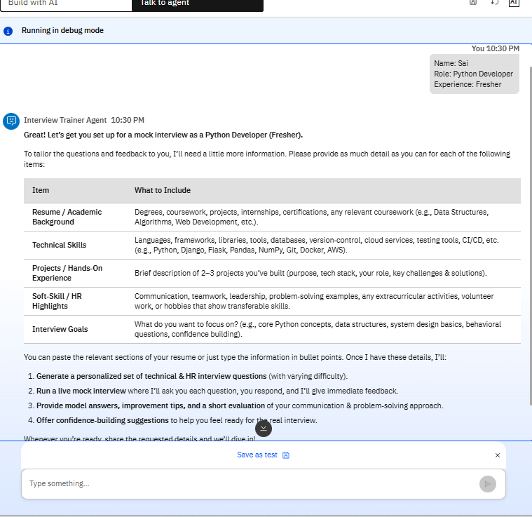
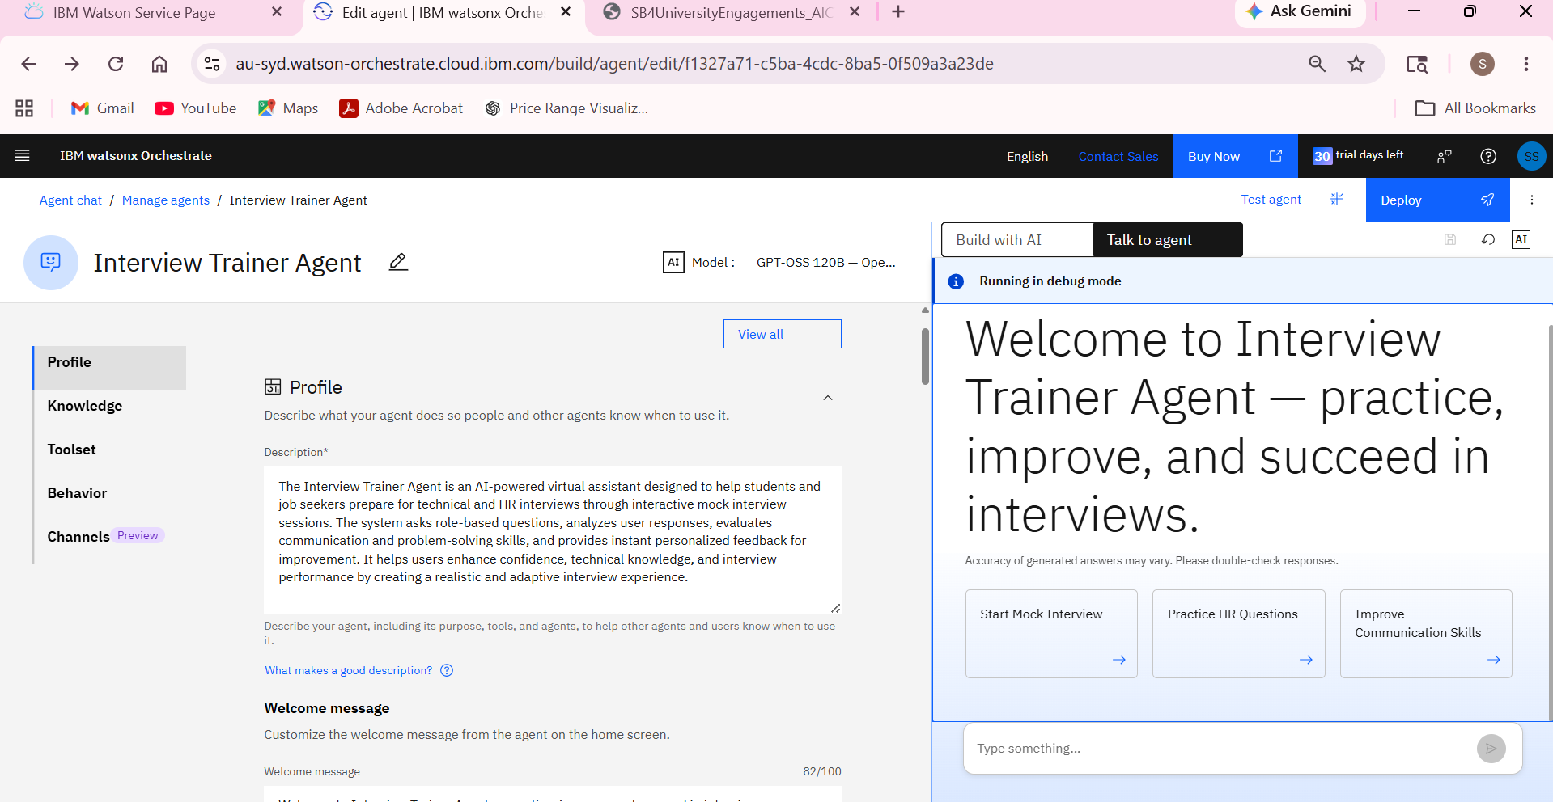
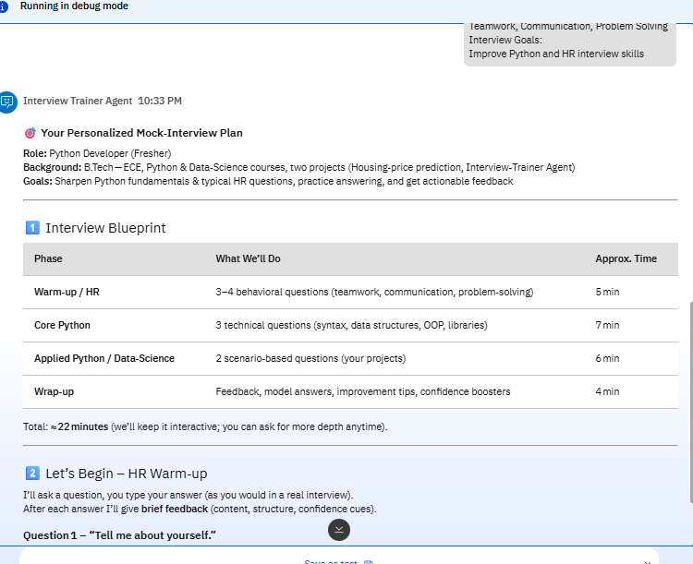
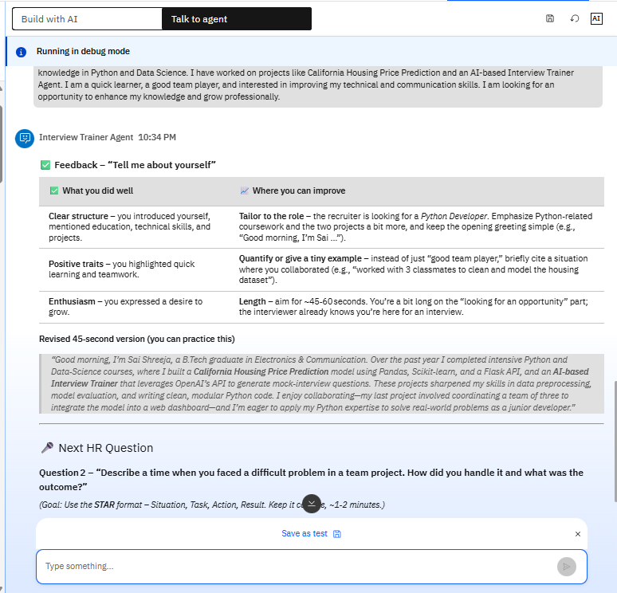
IBM Orchestrate Workflow

Slide 8
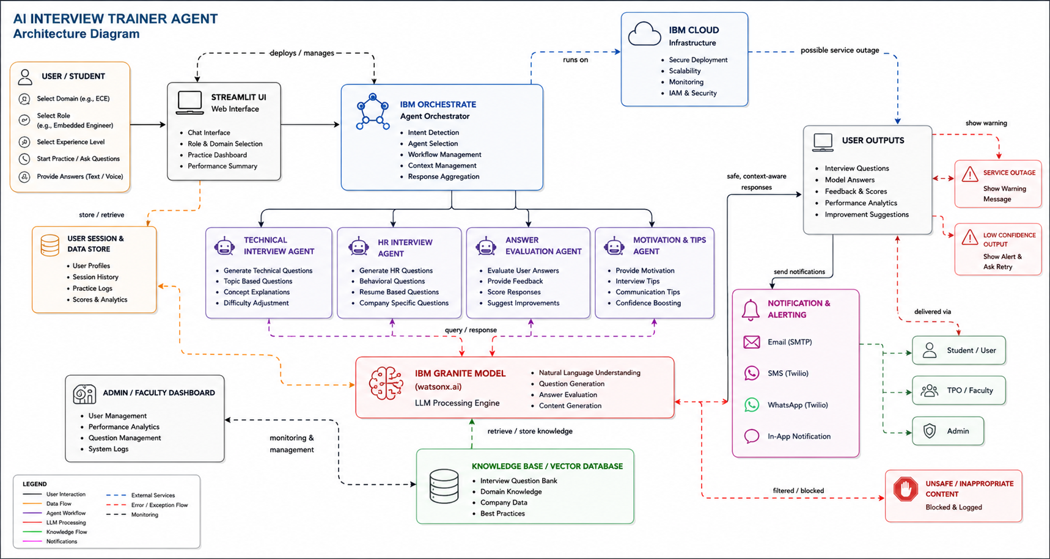
Architecture blueprint

Slide 9

Role of Agentic AI in the solution
Role of Agentic AI in the Solution
Agentic AI enables the Interview Trainer Agent to function as an intelligent and autonomous interview preparation system rather than a simple chatbot. Using IBM Orchestrate and IBM Granite Models, multiple specialized AI agents work together to generate technical and HR interview questions, evaluate user responses, and provide personalized feedback and improvement suggestions.
Each agent performs a specific task, such as technical question generation, HR interview preparation, and response evaluation, while collaborating with other agents to deliver accurate and context-aware interview guidance. Agentic AI also helps the system understand user domain, skill level, and interview requirements to provide personalized learning support and real-time interaction.
Overall, Agentic AI makes the system interactive, intelligent, adaptive, and goal-driven, helping students improve confidence, communication skills, and placement readiness effectively.

Slide 10
Technology Used
1. IBM Orchestrate:
Used for managing and coordinating multiple AI agents and workflows.
2. IBM Granite Models:
Used for generating interview questions, evaluating answers, and providing intelligent feedback.
3. IBM watsonx.ai:
Used for deploying and accessing IBM Granite AI models and cloud-based AI services.
4. Streamlit:
Used for developing the interactive frontend interface for students.
5. Python:
Used for backend development, workflow integration, and application logic.
6. RAG (Retrieval-Augmented Generation):
Used for retrieving relevant interview-related information and generating accurate AI responses.

Slide 11
Novelty and Uniqueness
The proposed Interview trainer Agent stands out by combining Agentic AI, RAG, and personalization into a single intelligent system.
Proposed Agentic System
1. User Interaction Agent:
Handles user interview requests and inputs.
2. Technical Interview Agent:
Generates technical interview questions.
3. HR Interview Agent:
Generates HR and behavioral questions.
4. Feedback Evaluation Agent:
Provides feedback and improvement suggestions.
5. IBM Granite AI Agent:
Generates intelligent responses using IBM Granite Models.
6. Agent Orchestrator:
Coordinates communication and workflow between all AI agents using IBM Orchestrate.

Slide 12
Future Scope
Personalization – The Interview Trainer Agent can be improved to provide highly personalized interview preparation based on the user’s skills, performance history, and target job role. It can dynamically adjust questions, difficulty levels, and feedback according to individual progress, making the training experience more effective and job-specific.
Multimodal – The system can be enhanced with multimodal capabilities to analyze not only text responses but also voice tone, speech clarity, and facial expressions during mock interviews. This will help in evaluating communication skills more accurately and provide detailed feedback to improve confidence and overall interview performance.
·
·
·

Slide 13


